Slide 1

KNOWLEDGE INSTITUTE OF TECHNOLOGY, SALEM – 637504
(Autonomous Institution)
MAP
2025
Fourth Review
Batch No.: 02
Club Name: SMART AUTOMATION CLUB
Team Members: B. Dharaneshwaran, A. Harish, R. Dharaneesh, R. Gokilnathan
Full Affiliation: III Year MECH, Knowledge Institute of Technology. Salem.
Name of the Mentor: Prof K.N. Karthick
Presentation Date: 05.05.2026

Slide 2
PROJECT JOURNEY
Problem identified from farmers
Initial concept developed
CAD model created
Prototype developed
Design modified based on mentor suggestion
Final working model achieved

Slide 3
PROBLEM STATEMENT
Coconut farmers face high labor costs and difficulty in weeding. Existing machines are heavy and may damage roots. A lightweight, safe, and cost-effective power weeder is required.

Slide 4
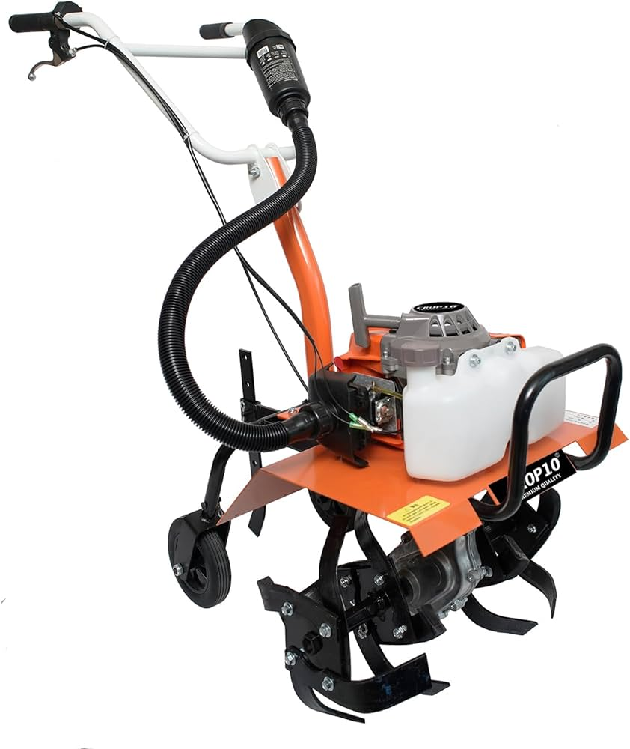
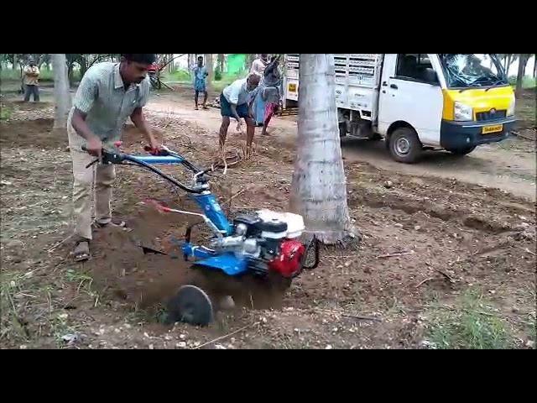
EXISTING SYSTEM ISSUES
Heavy machines
High cost
Root damage risk
Not suitable for small farms
Bulky and less portable
Engine-driven and heavy

Slide 5
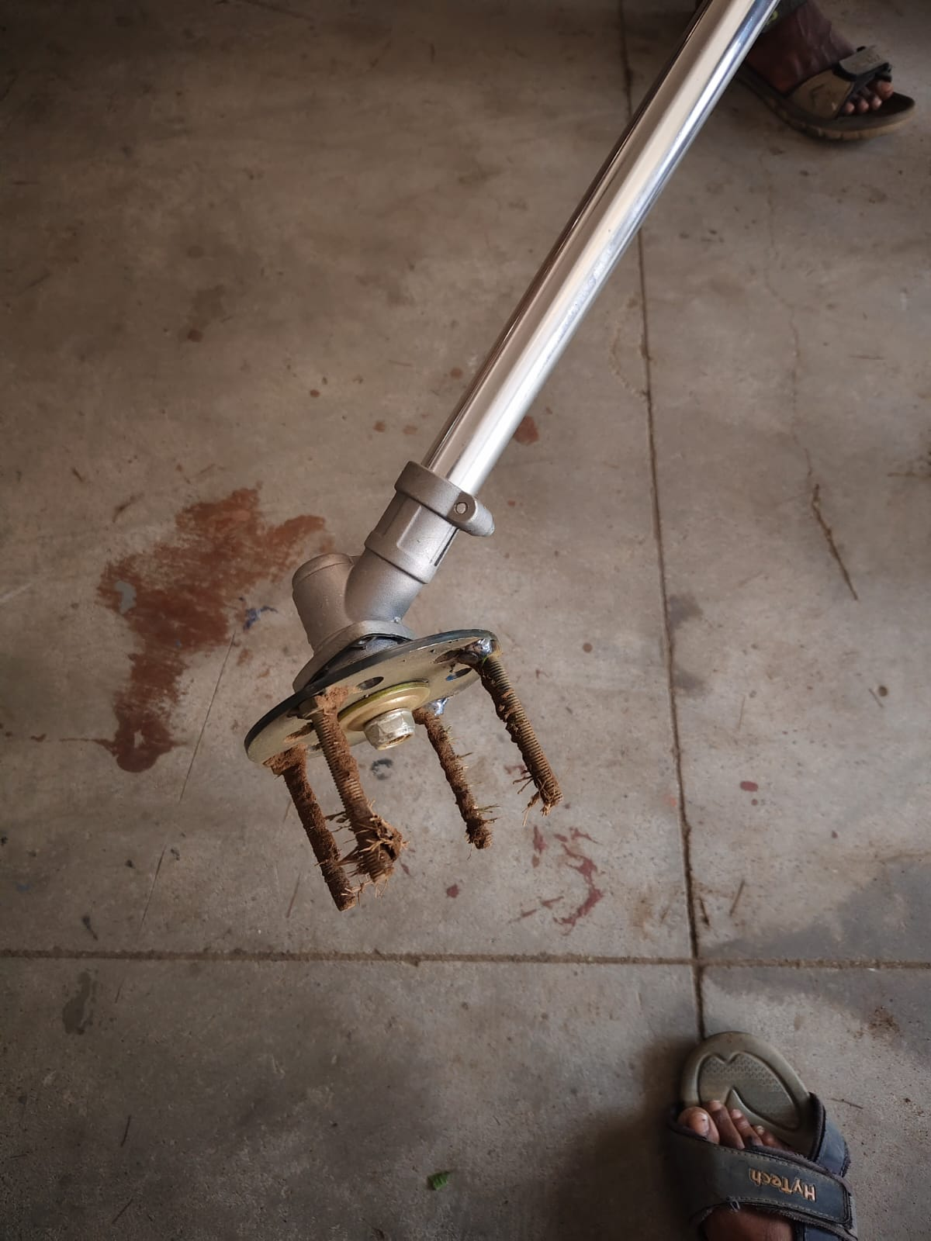
PROPOSED SOLUTION
Portable power weeder
Spiked disc mechanism
Low-cost design
Easy operation
Easy to operate and maintain

Slide 6
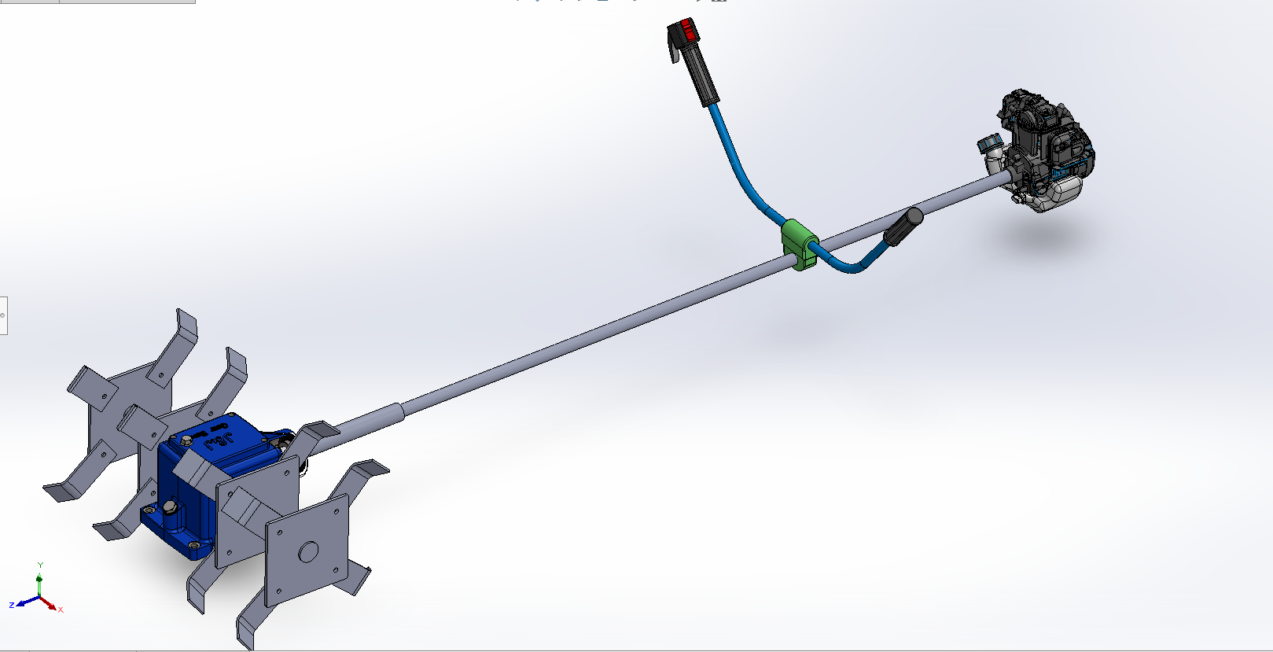
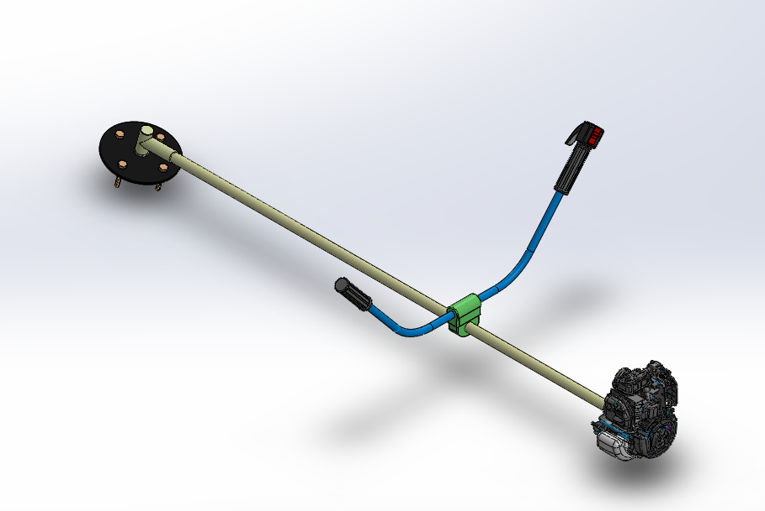
DESIGN EVOLUTION
Old Design
New Design
Used traditional cutting blade
Higher maintenance
Safety risk
Slightly complex fabrication
Replaced blade with spiked disc (bolt-nut type)
Easy to replace and maintain
Safer operation
Simplified structure

Slide 7
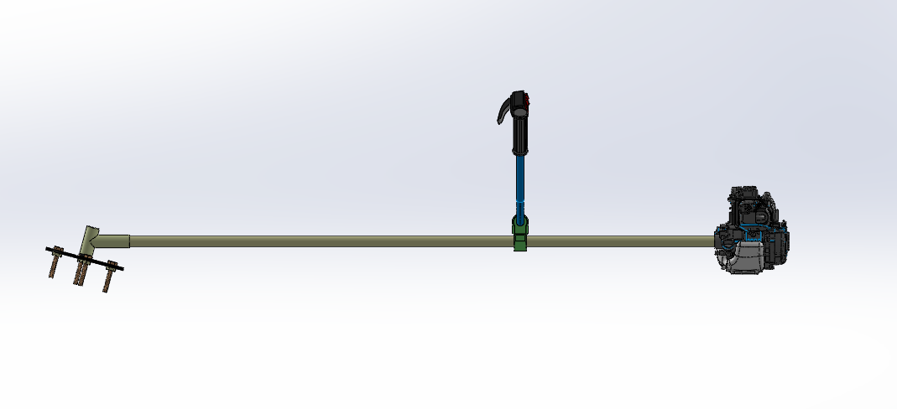
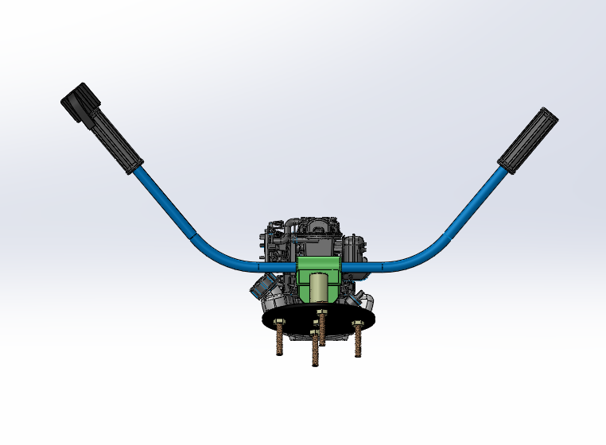
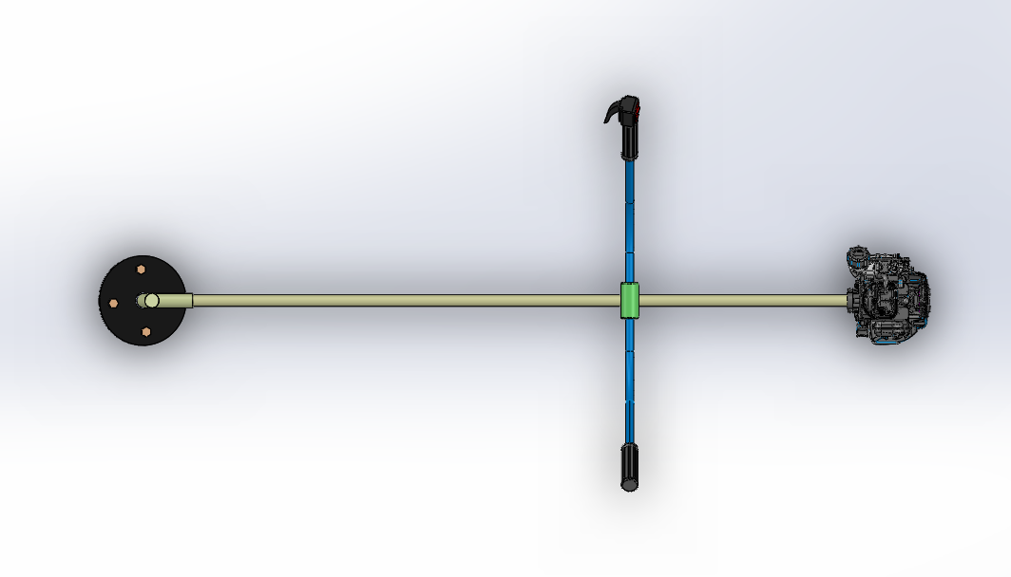
FINAL CAD MODEL
SIDE VIEW
FRONT VIEW
ISOMETRIC VIEW
TOP VIEW

Slide 8
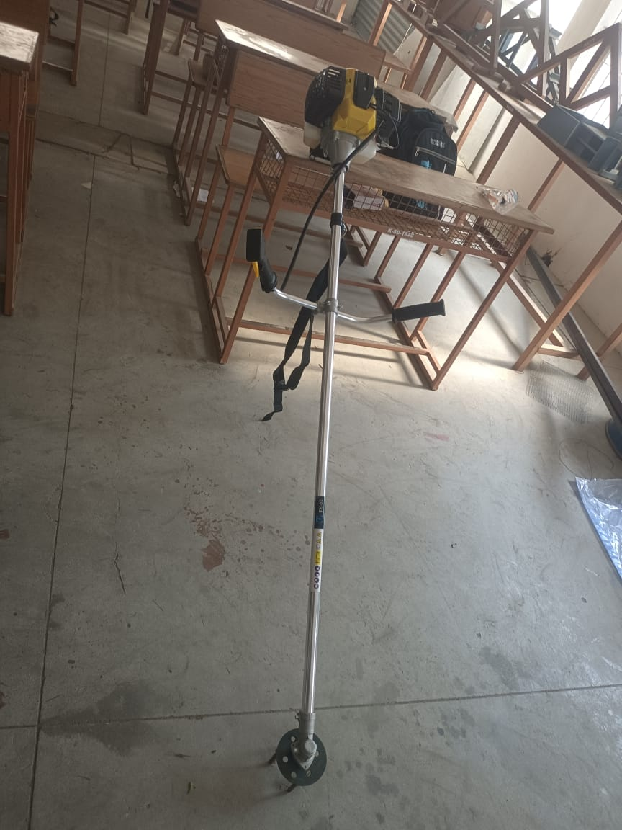
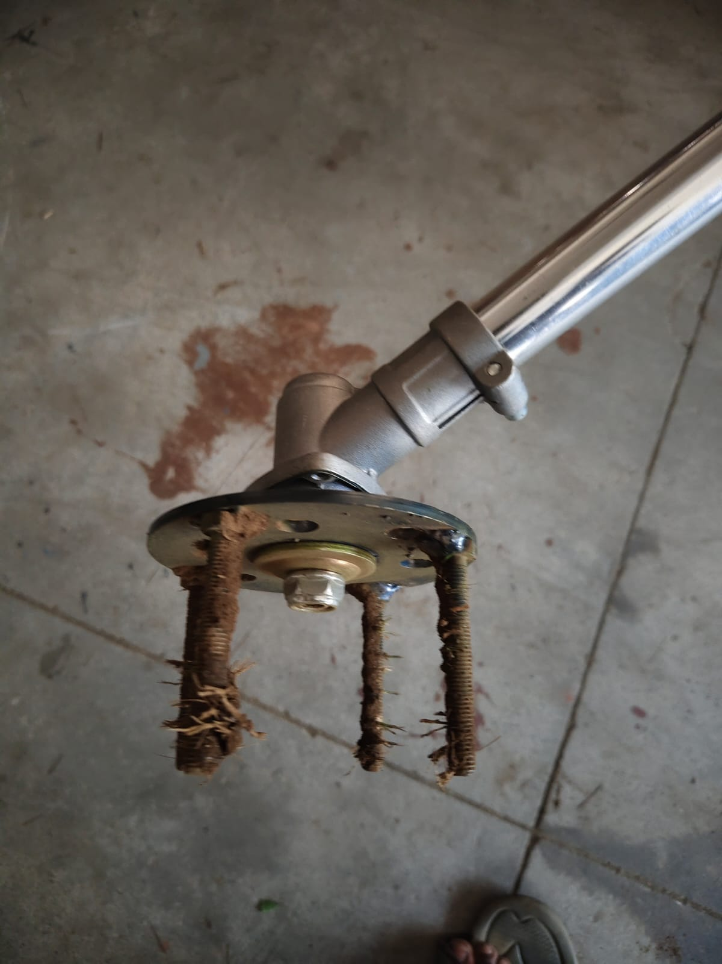
FINAL PRODUCT IMAGE

Slide 9
KEY FEATURES & ADVANTAGES
KEY FEATURES:
  Lightweight Machine
  Safe design
  Replaceable bolts
  Low maintenance
ADVANTAGES:
  Reduces labor cost
  Saves time
  Easy handling
  Suitable for coconut farms

Slide 10
BUSINESS MODEL
Target Customers
Value Proposition
Revenue Model
Small & Medium-scale farmers
Coconut Farm Owner
Agriculture Laborers
Equipment rental provides
Low-cost machine
Safe machine (no sharp blades)
Easy to maintenance
Suitable for narrow farm spaces
Direct product sales
Rental services
Spare parts (bolt, disc replacement)

Slide 11
STRATEGY & FUTURE SCOPE
Marketing Strategy
Future Scope
Live field demonstration
Local dealer distribution
Farmer word-of-mouth
Social media awareness
Battery-operated version
Gear system improvement
Multi-purpose attachment

Slide 12
COST ESTIMATION
No | Component | Description | Qty | Cost (₹)
1 | Engine / Motor Unit | Petrol engine (brush cutter type) | 1 | 3500
2 | Drive Shaft Assembly | Inner flexible shaft + outer pipe | 1 | 1200
3 | Handle Bar | Adjustable dual handle | 1 | 400
4 | Throttle Control | Switch + cable system | 1 | 200
5 | Gear Head | Angle gearbox for rotation | 1 | 800
6 | Frame / Mount | Support structure | 1 | 200
7 | Fasteners | Nuts, bolts, clamps | Set | 200
8 | Spiked Disc Plate | MS laser cut circular plate | 1 | 200
9 | Bolts (Spikes) | High strength bolts (spike purpose) | 10–12 | 80
10 | Nuts & Washers | For bolt fixing | Set | 40
11 | Center Hub | Disc mounting support | 1 | 50
12 | Laser Cutting Charges | Disc fabrication | — | 300
 | Total Cost |  |  | ₹6800

Slide 13
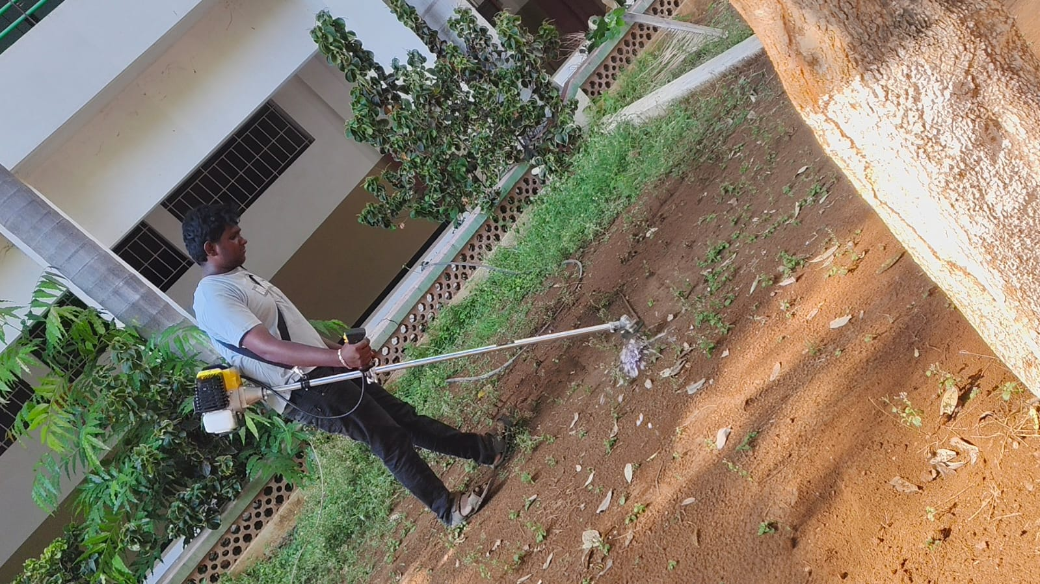
RESULTS & TESTING
Successfully removed weeds
Stable operation
No root damage observed
Easy to operate

Slide 14
CONCLUSION
The project successfully developed a low-cost, lightweight power weeder that improves efficiency and reduces labor dependency in coconut farming.

Slide 15
THANK YOU

